Slide 1
Tool sharing and code reading progress
SED 2019 Team 2
10/31

Slide 2
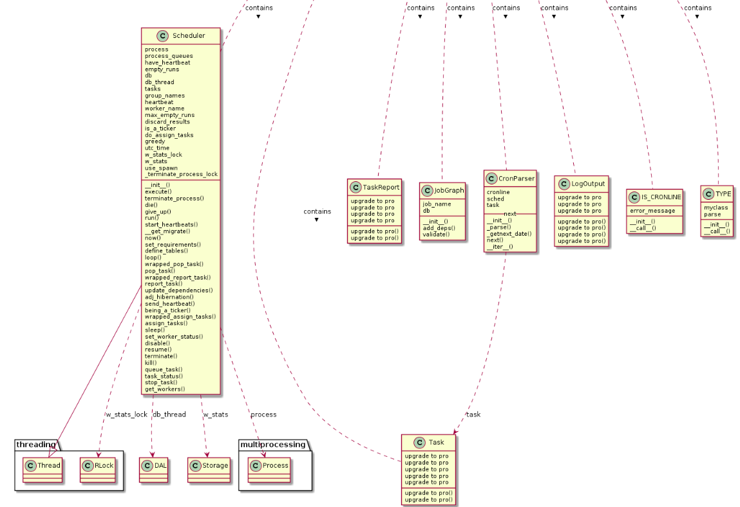
Pynsource
Advantage
Python 3 and Python 2 syntax support
Update in 2019 Mar.
Can transform into PlantUML
Disadvantage
Basic version can only support 5 files
1

Slide 3
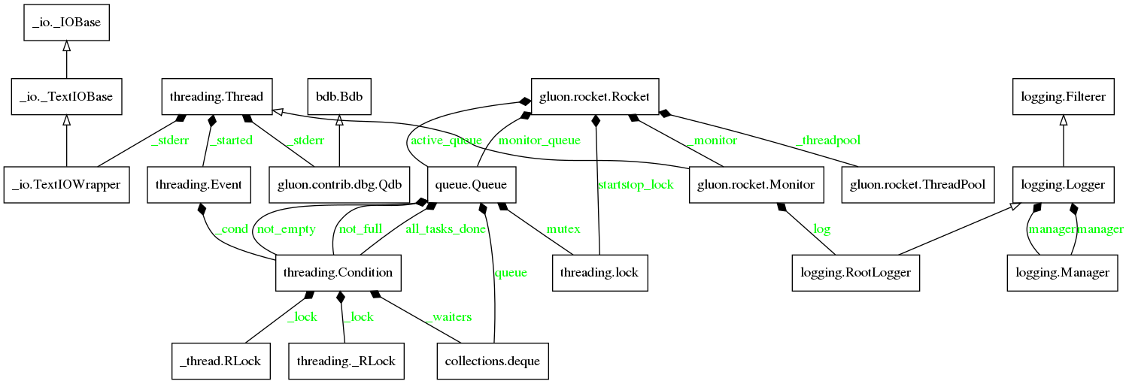
Pyreverse
Advantage
Free & open-source
Disadvantage
Fail to detect some dependency
Not well-maintained. Produce errors when analyzing some specific files.
2

Slide 4
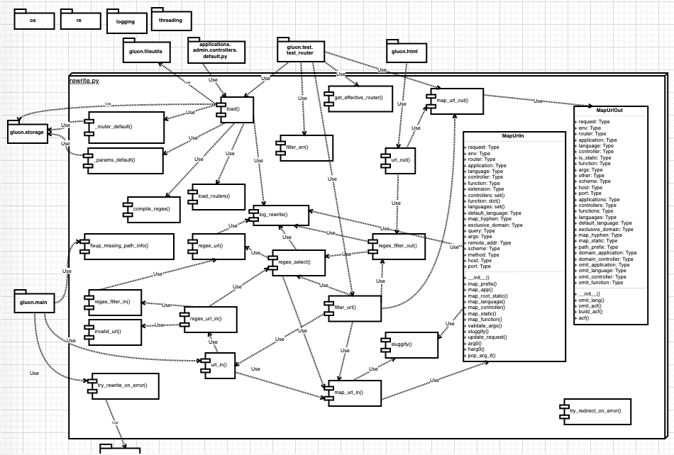
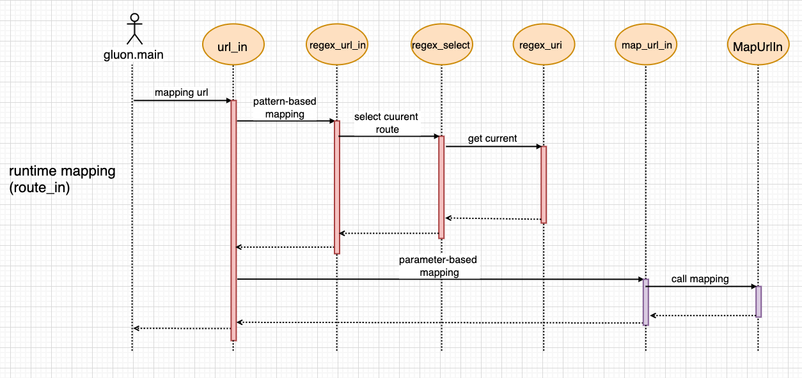
draw.io
Advantage
can draw class diagram
can draw sequence diagram
co-editing
Disadvantage
draw diagram by hand
very time-consuming
https://draw.io
3

Slide 5
code reading progress
4

Slide 6
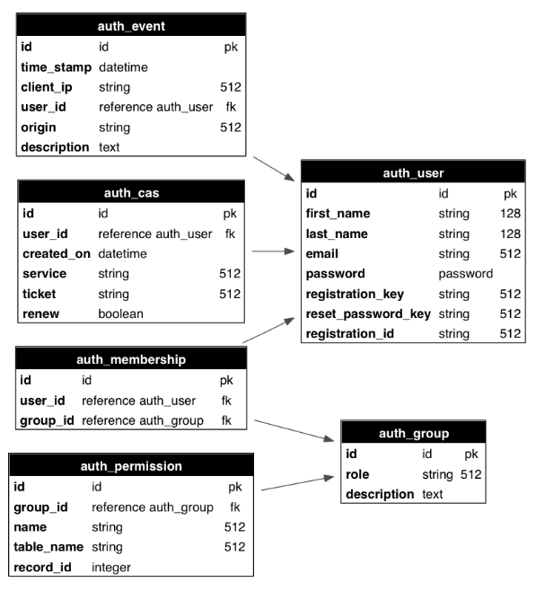
authapi.py -- Access Control
Role Based Access Control mechanism (RBAC)
Users are not assigned permissions directly, but only acquire them through their role (or roles), management of individual user rights becomes a matter of simply assigning appropriate roles to the user
The web2py class that implements RBAC is called Auth
5

Slide 7
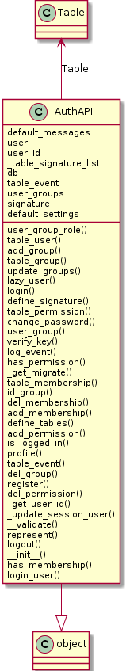
authapi.py (cont.)
# of lines: 1059
# of member function: 35
# of member variables: 8
A barebones Auth implementation
The main Auth functions are designed in a Dict In -> Dict Out logic
No builtin CSRF protection whatsoever
6

Slide 8
authapi.py (cont.)
def __init__(self, db=None, hmac_key=None, signature=True)
Depend on whether auth info is expired or not to renew the session
def define_signature(self)
Initiate a auth_signature table and set the related attributes
def define_tables(self, username=None, signature=None, migrate=None, fake_migrate=None)
defines all needed tables
7

Slide 9
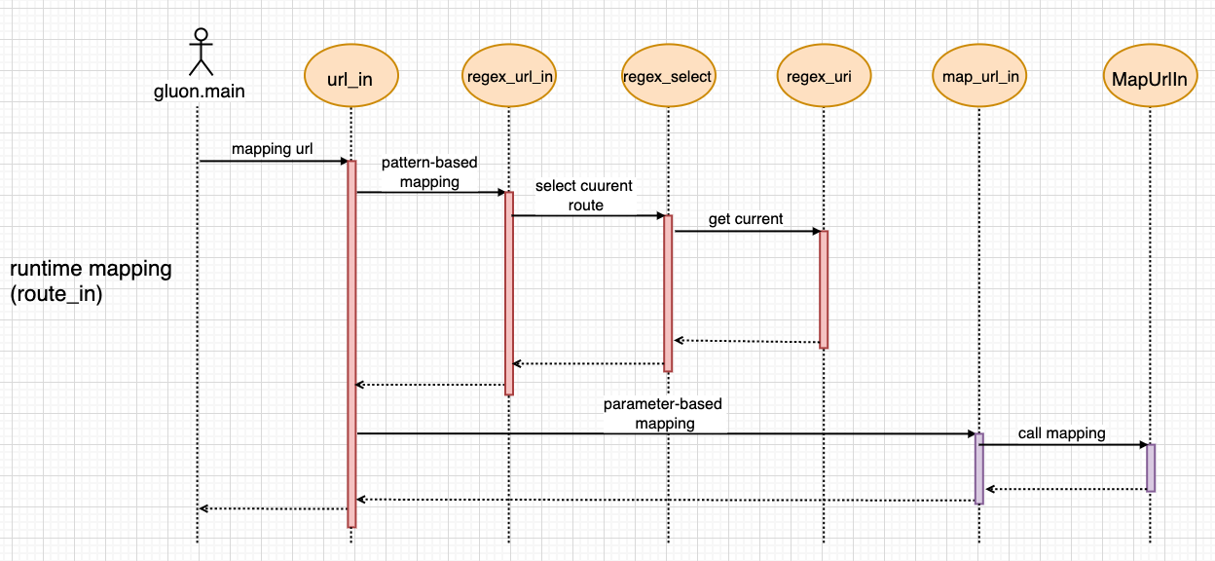
rewrite.py
Notes:
only call when developer specify routes.py under their application or infrastructure
routes.py can be written in two different patterns
use THREAD_LOCAL for threads to deal with each request
what it does
route_in: (http://domain.com/xyz → http://domain.com/a/b/c)
route_out: (http://domain.com/a/b/c → http://domain.com/xyz)
How it does
8
Notes:
Developer can write routes.py to rewrite url and dispatch request to the wanted application handler.

Slide 10
globals.py
Contain classes for the global used variables
global variables and functions
current: store thread-specific data as attributes, usage across multiple files
classes: Request, Response, Session
9

Slide 11
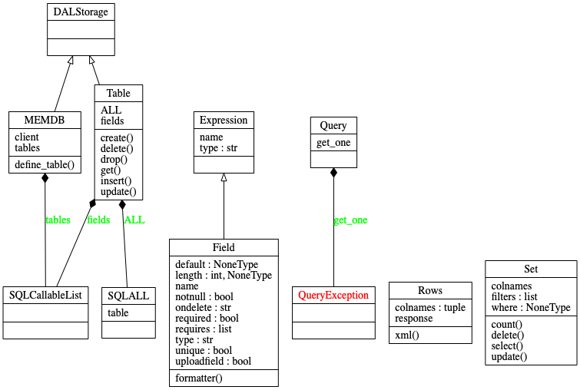
memdb.py
10

Slide 12
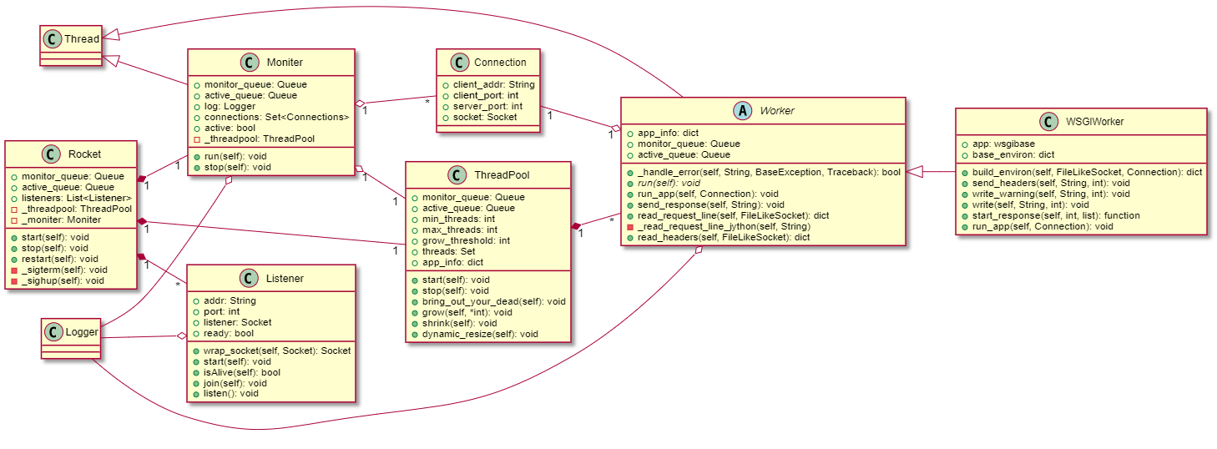
rocket.py
(Drawn with plantUML)
11

